Slide 1

Introductory Statistics
Introductory Statistics

Slide 2
Outline of the Presentation
Law of Large Numbers
Distribution of Sample Means when Parent Population is NOT Normally Distributed
Distribution of Sample Means when Parent Population is Normally Distributed
Key Points

Slide 3
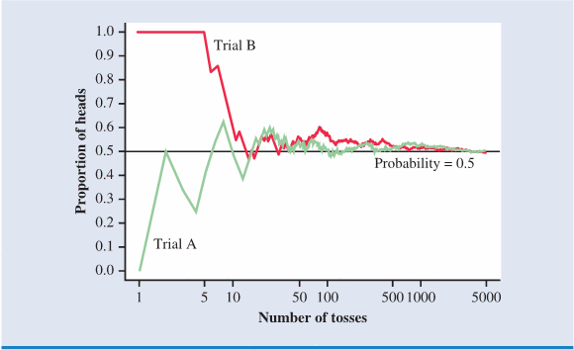
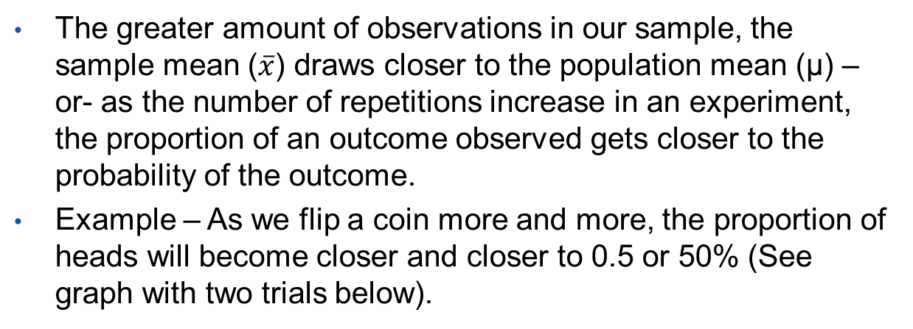
The Law of Large Numbers – A Brief Summary
The greater amount of observations in our sample, the sample mean ($\overline{x}$) draws closer to the population mean (µ) –or- as the number of repetitions increase in an experiment, the proportion of an outcome observed gets closer to the probability of the outcome.
Example – As we flip a coin more and more, the proportion of heads will become closer and closer to 0.5 or 50% (See graph with two trials below).

Slide 4
Outline of the Presentation
Law of Large Numbers
Distribution of Sample Means when Parent Population is NOT Normally Distributed
Distribution of Sample Means when Parent Population is Normally Distributed
Key Points

Slide 5
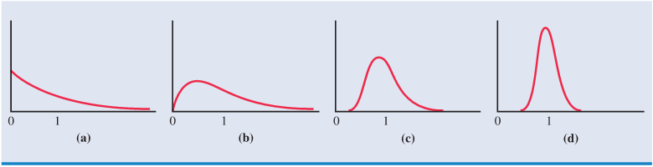
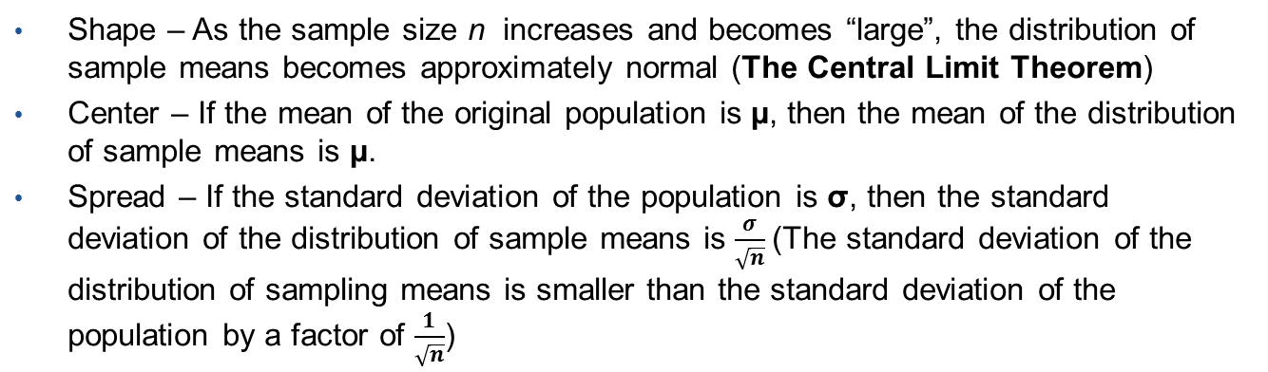
Distribution of Sample Means when Parent Population is Not Normally Distributed
Shape – As the sample size n increases and becomes “large”, the distribution of sample means becomes approximately normal (The Central Limit Theorem)
Center – If the mean of the original population is µ, then the mean of the distribution of sample means is µ.
Spread – If the standard deviation of the population is σ, then the standard deviation of the distribution of sample means is $\frac{σ}{\sqrt{n}}$(The standard deviation of the distribution of sampling means is smaller than the standard deviation of the population by a factor of $\frac{1}{\sqrt{n}}$)
Original Population
Sampling Dist. (n=5)
Sampling Dist. (n=15)
Sampling Dist. (n=25)
Sampling Distribution -> Distribution of Sample means ($\overline{x}$)
Applet - http://onlinestatbook.com/stat_sim/sampling_dist/index.html

Slide 6
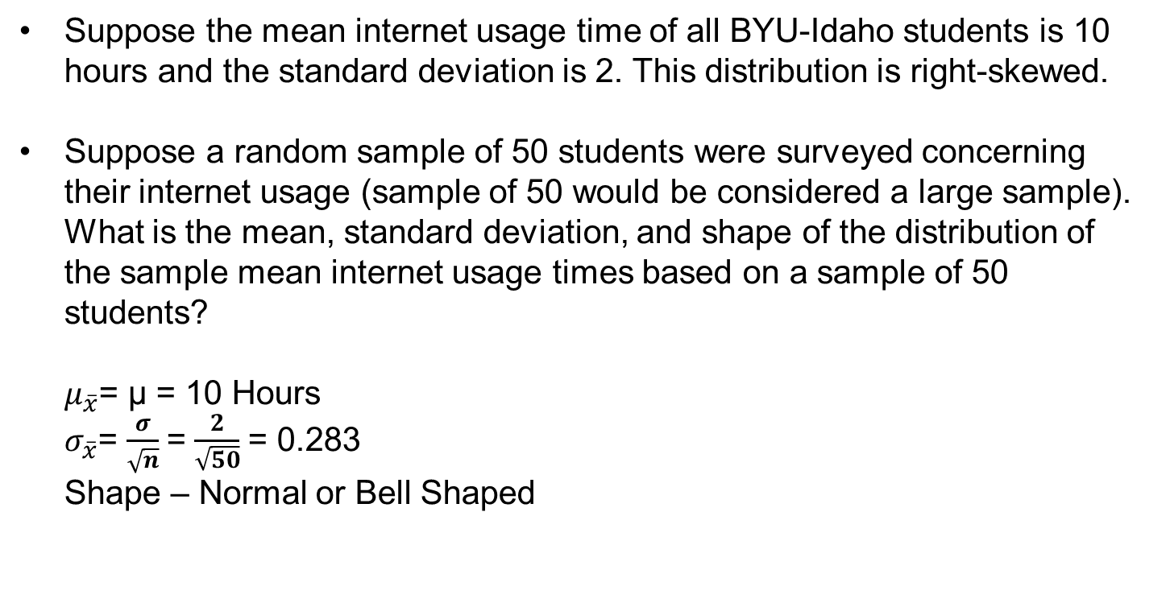
Distribution of Sample Means when Parent Population is Not Normally Distributed
Suppose the mean internet usage time of all BYU-Idaho students is 10 hours and the standard deviation is 2. This distribution is right-skewed.
Suppose a random sample of 50 students were surveyed concerning their internet usage (sample of 50 would be considered a large sample). What is the mean, standard deviation, and shape of the distribution of the sample mean internet usage times based on a sample of 50 students?
$μ_{\overline{x}}$= μ = 10 Hours
$σ_{\overline{x}}$= $\frac{σ}{\sqrt{n}}$= $\frac{2}{\sqrt{50}}$= 0.283
Shape – Normal or Bell Shaped

Slide 7
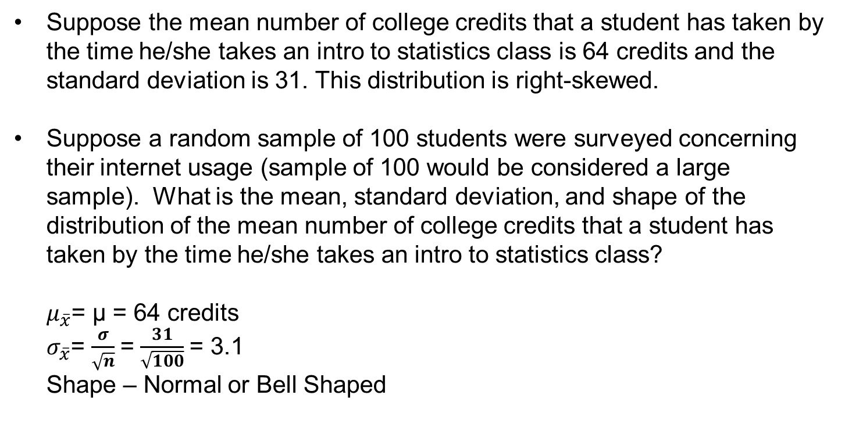
Distribution of Sample Means when Parent Population is Not Normally Distributed
Suppose the mean number of college credits that a student has taken by the time he/she takes an intro to statistics class is 64 credits and the standard deviation is 31. This distribution is right-skewed.
Suppose a random sample of 100 students were surveyed concerning their internet usage (sample of 100 would be considered a large sample). What is the mean, standard deviation, and shape of the distribution of the mean number of college credits that a student has taken by the time he/she takes an intro to statistics class?
$μ_{\overline{x}}$= μ = 64 credits
$σ_{\overline{x}}$= $\frac{σ}{\sqrt{n}}$= $\frac{31}{\sqrt{100}}$= 3.1
Shape – Normal or Bell Shaped

Slide 8
Outline of the Presentation
Law of Large Numbers
Distribution of Sample Means when Parent Population is NOT Normally Distributed
Distribution of Sample Means when Parent Population is Normally Distributed
Key Points

Slide 9
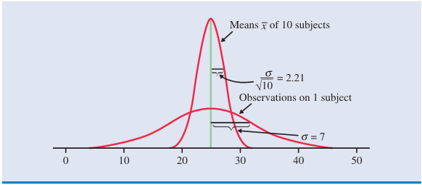
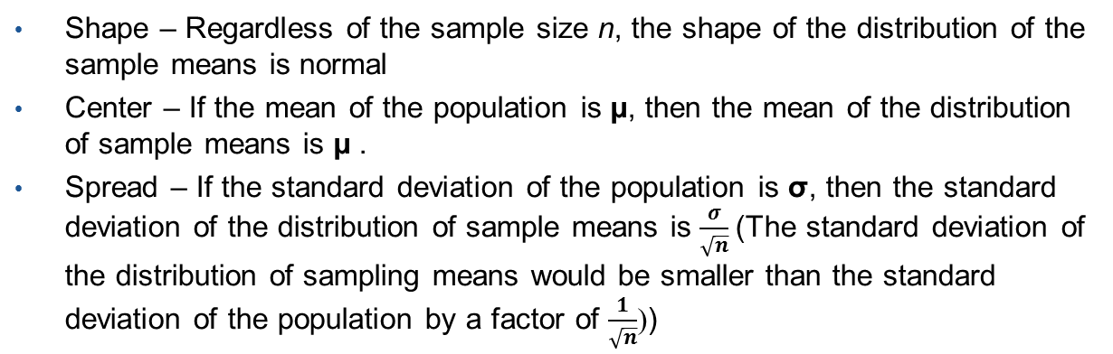
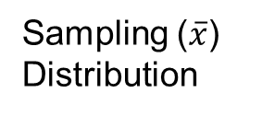
Distribution of Sample Means when Parent Population is Normally Distributed
Shape – Regardless of the sample size n, the shape of the distribution of the sample means is normal
Center – If the mean of the population is µ, then the mean of the distribution of sample means is µ .
Spread – If the standard deviation of the population is σ, then the standard deviation of the distribution of sample means is $\frac{σ}{\sqrt{n}}$(The standard deviation of the distribution of sampling means would be smaller than the standard deviation of the population by a factor of $\frac{1}{\sqrt{n}}$))
Sampling ($\overline{x}$)
Distribution
Population
Distribution
Sampling Distribution -> Distribution of Sample means ($\overline{x}$)

Slide 10
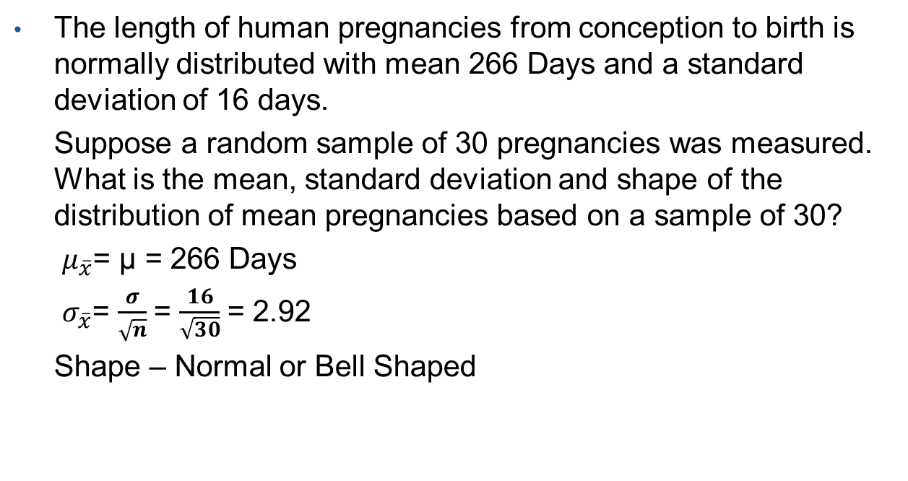
Distribution of Sample Means when Parent Population is Normally Distributed
The length of human pregnancies from conception to birth is normally distributed with mean 266 Days and a standard deviation of 16 days.
Suppose a random sample of 30 pregnancies was measured. What is the mean, standard deviation and shape of the distribution of mean pregnancies based on a sample of 30?
$μ_{\overline{x}}$= μ = 266 Days
$σ_{\overline{x}}$= $\frac{σ}{\sqrt{n}}$= $\frac{16}{\sqrt{30}}$= 2.92
Shape – Normal or Bell Shaped

Slide 11

Distribution of Sample Means when Parent Population is Not Normally Distributed
The heart rate (beats per minute) for a typical college student is normally distributed with mean of 80 and a standard deviation of 16.5 days.
Suppose a random sample of 10 students was measured. What is the mean, standard deviation and shape of the distribution of mean heart rates (beats per minute) for a typical college student based on a sample of 10?
$μ_{\overline{x}}$= μ = 80 beats per minute
$σ_{\overline{x}}$= $\frac{σ}{\sqrt{n}}$= $\frac{16.5}{\sqrt{10}}$= 5.22
Shape – Normal or Bell Shaped

Slide 12
Outline of the Presentation
Law of Large Numbers
Distribution of Sample Means when Parent Population is NOT Normally Distributed
Distribution of Sample Means when Parent Population is Normally Distributed
Key Points

Slide 13
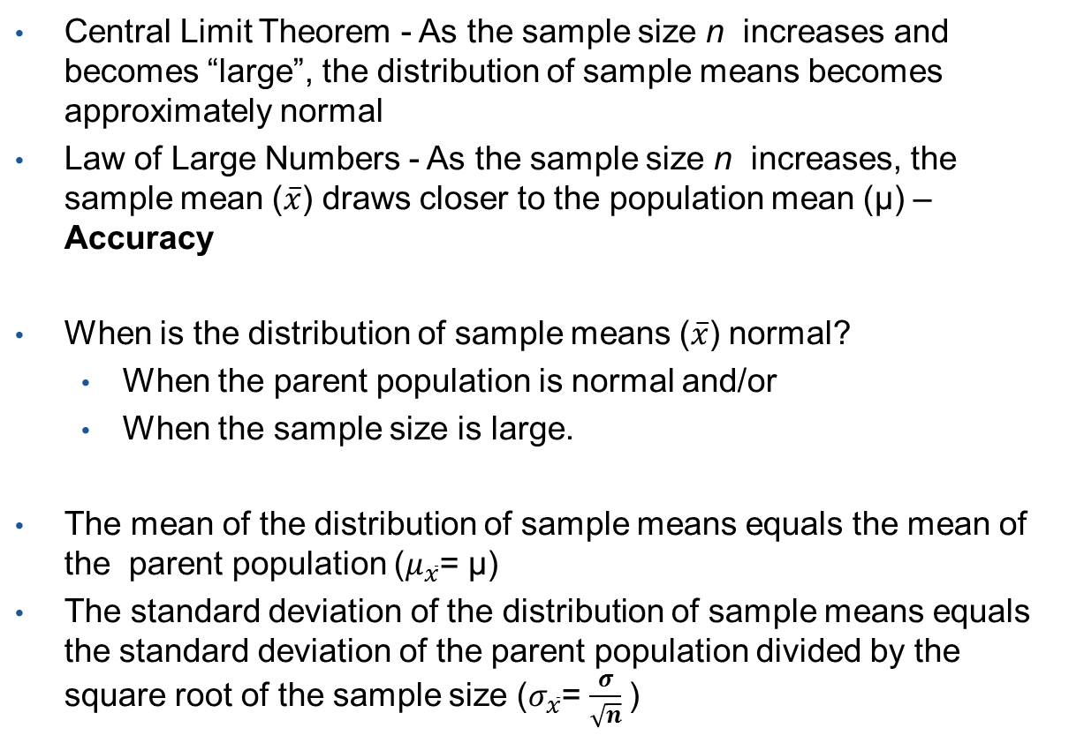
Key Points
Central Limit Theorem - As the sample size n increases and becomes “large”, the distribution of sample means becomes approximately normal
Law of Large Numbers - As the sample size n increases, the sample mean ($\overline{x}$) draws closer to the population mean (µ) – Accuracy
When is the distribution of sample means ($\overline{x}$) normal?
When the parent population is normal and/or
When the sample size is large.
The mean of the distribution of sample means equals the mean of the parent population ($μ_{\overline{x}}$= μ)
The standard deviation of the distribution of sample means equals the standard deviation of the parent population divided by the square root of the sample size ($σ_{\overline{x}}$= $\frac{σ}{\sqrt{n}}$)

